Slide 1
ONLINE QUIZ GAME

Slide 2
WELCOME
“ONLINE QUIZ GAME” IS A PROJECT BASED ON WEB APPLICATION
SUBMITTED BY
HEMANGI RAVINDRA MORE (196029)
SHRUTI RAJESH SONTAKKE (196056)
DNYANESHWARI KISHOR SUDHAL (196057)
SANIKA MAHADEV MAYEKAR (196025)
SONALI RAMA SALGUDE (196049)
UNDER GUIDENCE OF
PROF. P.V.KOLE

Slide 3
THIS PROJECT CONTAINS…
Introduction
Aim of Project
Existing System
Features of E-Quiz Game
Requrnment Analysis
Description of software Envoirnment
Design
Front end
Quiz Design
Back end
Conclusion
Reference

Slide 4

INTRODUCTION
“Practice like you have never won…Perform like you have never lost…!!!”

Slide 5

INTRODUCTION
E-Quiz is based on web app ehich can used for education purposes.
It is helps to students to offer a quick and easy way to appear for the test.
It is also needed to handle the examination
Organuzation can also easily monitor the progress of the student taat they give through the examination. As a result o this, the result is calculated in les time.
It is also help diminitioning the need of paper.
There is Adminitstrator and Faculty to manage yhe whole quiz, they assign the subject to that particular student. They manage the record of quiz , they have rights to handle the whole process.
Student can give a test by their any devices, They just login on their username and password and submit the test in particular time.They can see their history of their quiz.

Slide 6

AIM OF PROJECT
To increase the knowledge, to test their knowledge.
The student can give their exam without going to exam center.
It is totally based on Web.
It is fast and secure quiz game.
The main goal of this E-Quiz game is to efficiently evaluate the student through a totally automated system that not only reduce the required time but also obtain fast and accurate result.

Slide 7

EXISTING SYSTEM
This system is required to prepare registration form , question paper for the student and required to print a lot of number manually. Following are some problem which faculty or student don’t face in e-quiz :-
Time consuming for creating question paper
Time to check right and wrong answers
Calculation of marks
Human error
Limitation of number of student can give examination at a time
Require teacher to monitor exam center
Student needs to come exam center for giving test

Slide 8
FEATURES OF E-QUIZ GAME
Login Page :- This page helps to secure the project data and also help to manage user’s access.
Home Page :- It is the welcoming page and here is user redirected after logging to system, also quiz
summary can be seen
Faculty Page :- Creating , Updating ,Deleting dat aof the faculty
Student Page :- Student data can listed
Quiz list for Faculty
Here can faculty create quizesses and add student who can take the quiz. Admin can also maange quiz
Quiz list for Student
On this page student quizesses can be listed
Quiz Record Page
Admin and faculty see the record of the student each quiz

Slide 9

REQUIREMENT ANALYSIS
SOFTWARE REQUIREMENT
Front End = HTML, CSS , JAVASCRIPT
Back End = PHP, MYSQL
Brower End = Google Chrome, Opera Mozilla
Software Used = Xamp Server
HARDWARE REQUIREMENT
Client Side =
Intel core i5 processor , 2GB RAM
Server Side =
Intel core i5 Processor, minimum 6gb RAM , 1 TB harddisk

Slide 10
DESCRIPTION OF S/W ENVIRONMENT
1.HTML:
The HyperText Markup Language or HTML is the standard markup language for documents designed to be displayed in a web browser. It can be assisted by technologies such as Cascading Style Sheets (CSS) and scripting languages such as JavaScript.
2.CSS:
Cascading Style Sheets (CSS) is a style sheet language used for describing the presentation of a document written in a markup language such as HTML. CSS is a cornerstone technology of the World Wide Web, alongside HTML and JavaScript.
3.Javascript:
JavaScript often abbreviated JS, is a programming language that is one of the core technologies of the World Wide Web, alongside HTML and CSS. Over 97% of websites use JavaScript on the client side for web page behavior,[12] often incorporating third-party libraries.[13] All major web browsers have a dedicated JavaScript engine to execute the code on users' devices.

Slide 11
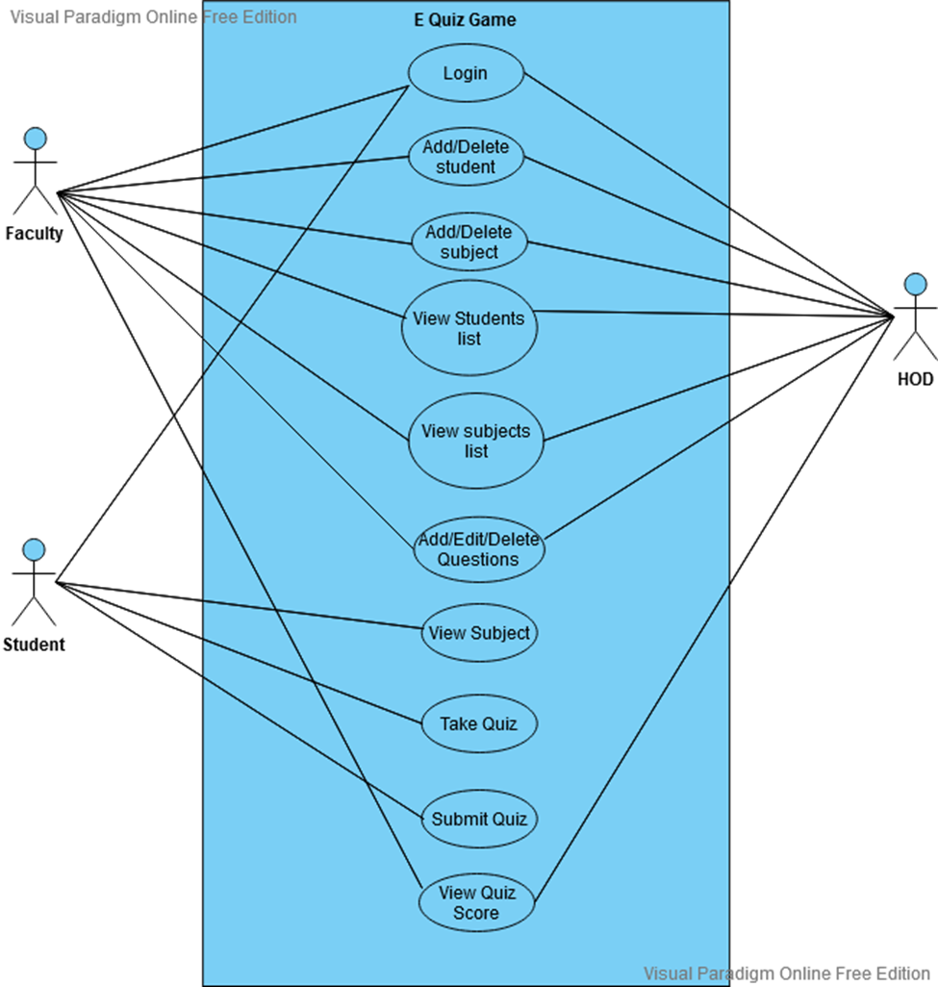
DESIGN

Slide 12
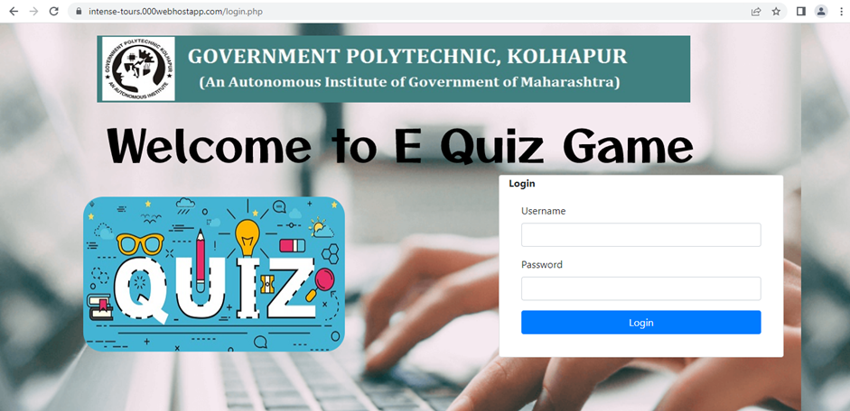
FRONT END LOGIN PAGE
.

Slide 13
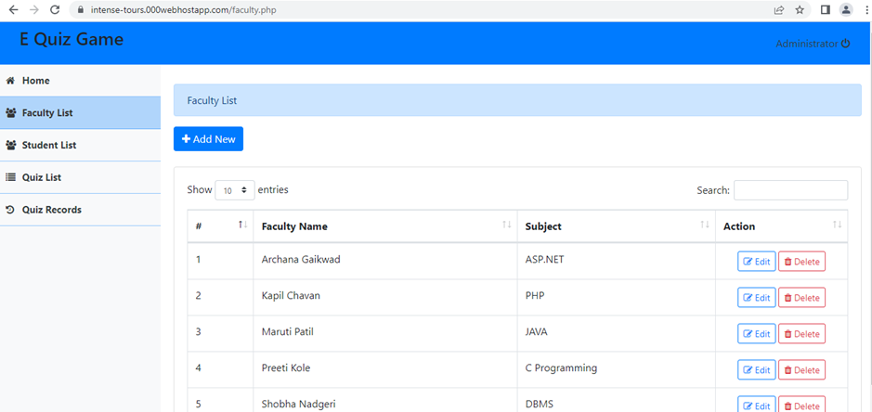
HOD DASHBOARD

Slide 14
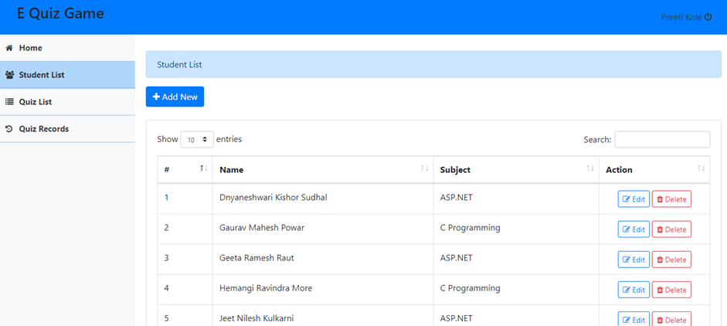
FACULTI DASHBOARD

Slide 15
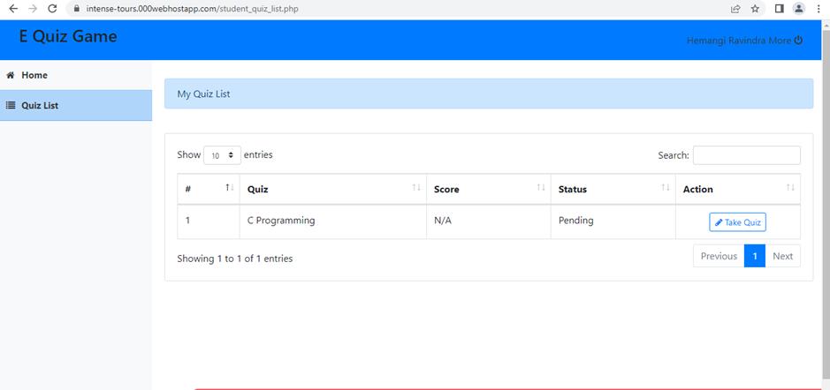
STUDENT DASHBOARD

Slide 16
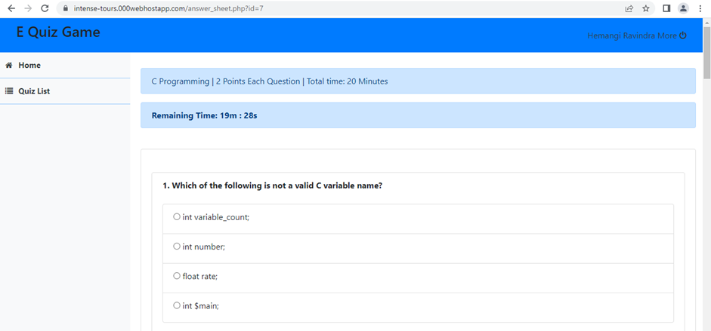
QUIZ PAGE

Slide 17
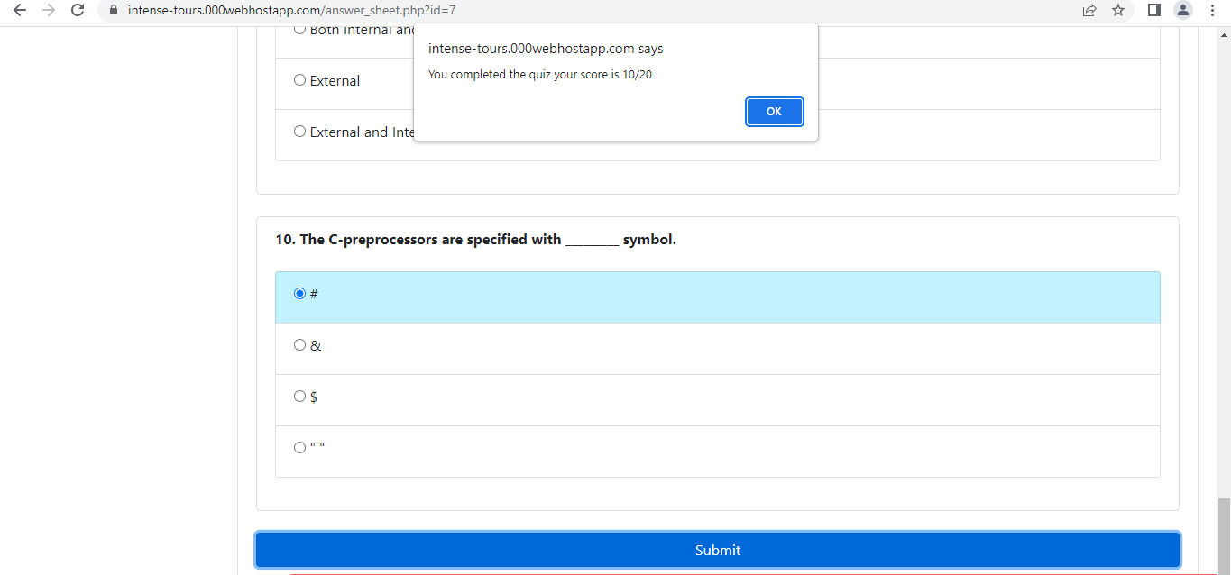
QUIZ SCORE ALERT

Slide 18
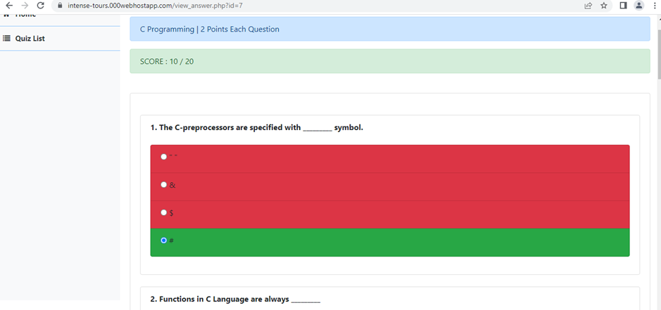
VIEW ANSWER SHEET

Slide 19
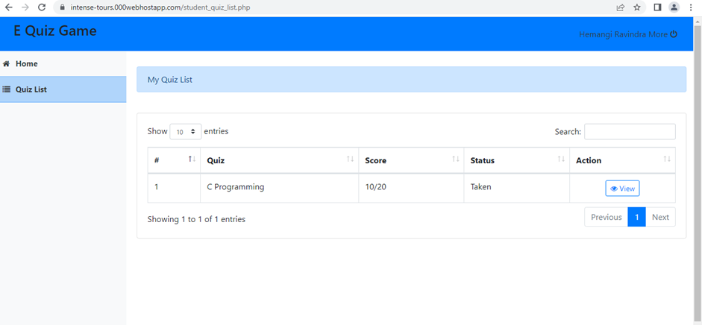
STUDENT STATUS AFTER ATTEMTING EXAM

Slide 20
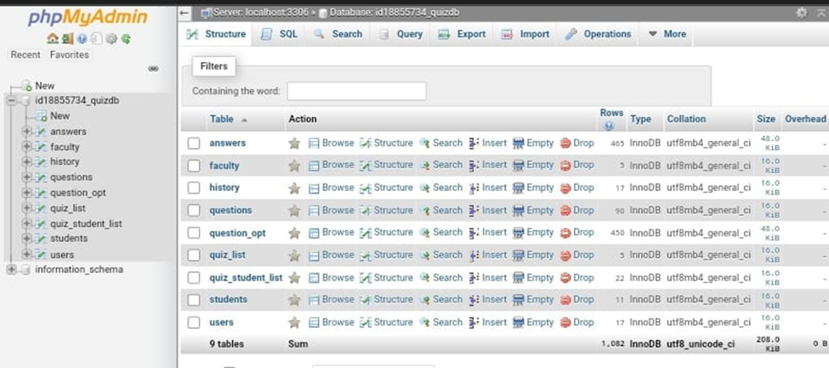
BACK END DATACASE VIEW

Slide 21
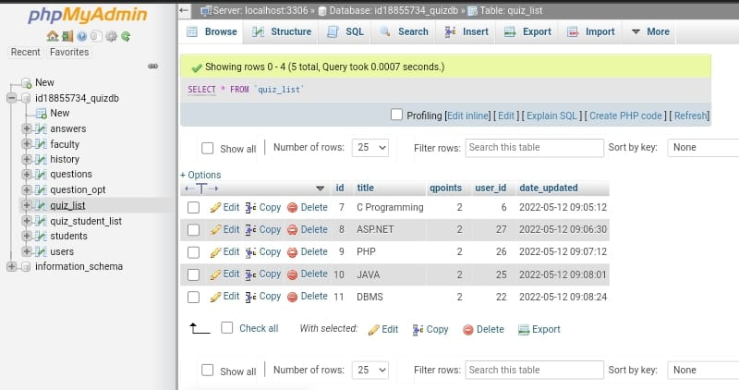
DATABASE

Slide 22
CONCLUSION
With the completion of this project I conclude that it has achieved its purpose. The whole project provides a base for students to take their exam using software and allow lecturers to add questions and answers into the system. The system is developed using PHP, HTML, CSS, Javascript and data are saved in the MYSQL database.
E Quiz game for introduction to management course is the best compared to paper-based exam. The automated system helps students and lecturers to save time and makes the process faster. It saves space since answers papers will not be used. With a user friendly system that has security, integrity and the database is neither inconsistent nor redundant.

Slide 23
REFERENCE
• Book : Php And Mysql In Easy by Mike Mcgrath
• Book : Beginning PHP and MySQL by Jason Gilmore
• www.programmer2programmer.net
• www.readymadeproject.coom
• http://ajprofessionals.googlepages.com/
• www.wikipedia.org
• www.php.net

